Slide 1
Digital Defense: Mastering Cybersecurity Basics
Day 1: Security Concepts and Model

Slide 2



Profile
Asst. Professor. Dr. Julia Juremi
Network, Security & Forensics
School of Technology, APU
Certified SOC-IR (Security Operation Center-Incident Responder)
Certified Fortinet Certified Associate Cybersecurity
Certified CompTIA Cybersecurity Analyst CySA+
Certified CompTIA PenTest+
EC Council Certified Ethical Hacker CEH
RCCE Rocheston Cyber Security Engineer
ISACA CSX Cybersecurity Fundamental
Certified TecForte SOC (Train the Trainer)
HRDF Train the Trainer Certified

Slide 3
Topic & Structure of The Lesson
Overview of Digital World
Digital Footprints
CIA and AAA
Defense in Depth

Slide 4
Learning Outcomes
At the end of this topic, You should be able to
Explain overview of security technologies and common terms
Explain security concepts and models
Explain the concept of defense in depth

Slide 5
Key Terms You Must Be Able To Use
If you have mastered this topic, you should be able to use the following terms correctly in your assignments and exams:
Active Digital Footprint
Passive Digital Footprint
Vulnerabilities
Threats
Attack
Exploit
Risk
CIA Triad
AAA

Slide 6
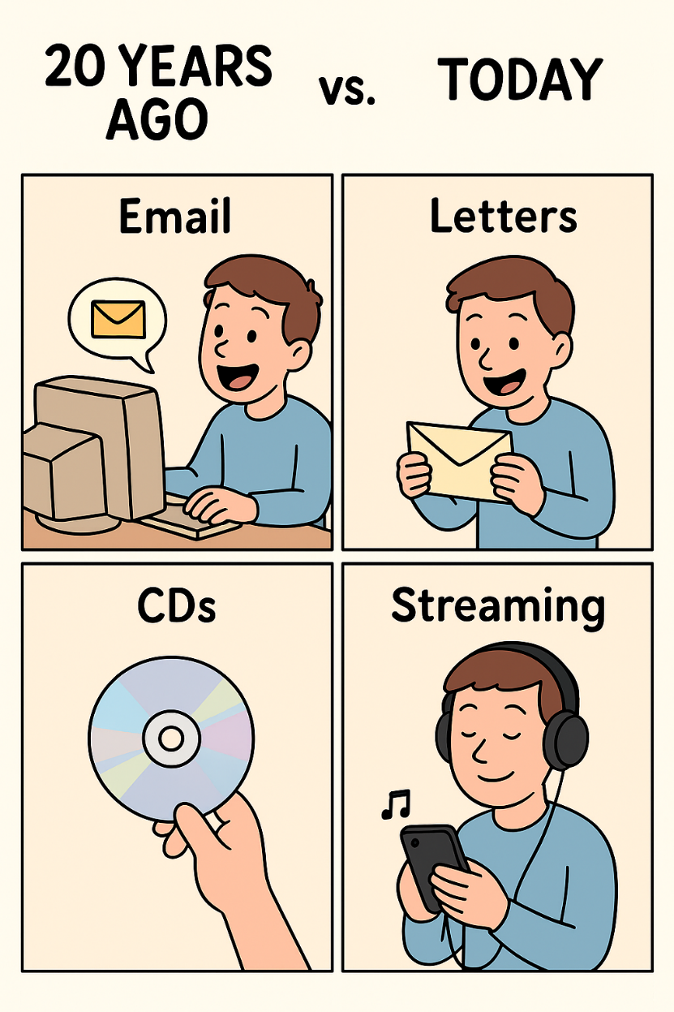
Overview of Digital World
The evolution of information systems has:
Invades every aspect of the average person’s life in today’s society.
E.g., sending an e-mail, writing a document, taking a picture with your digital camera, surfing the web, driving in your car with the GPS, online shopping, etc.

Slide 7
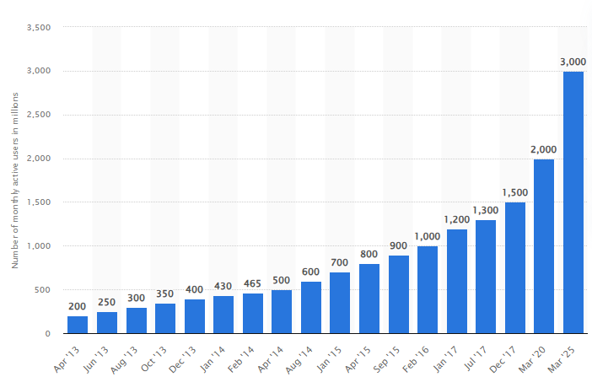
Whatsapp Monthly Users (2013-2025)
WhatsApp had approximately 3.14 billion to 3.2 billion monthly active users (MAUs) worldwide in 2025, with projections indicating the user base is expected to grow to over 3.2 billion by the end of the year

Slide 8
DIGITAL FOOTPRINT

Slide 9







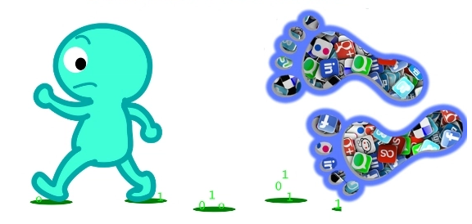
WHAT IS DIGITAL FOOTPRINTS?
A trail of data you created while using the Internet

Slide 10
Digital Footprint
No matter what you are doing these days, a digital footprint is probably being created that contains some type of digital evidence that can be recovered.
It includes the websites you visit, emails you send, and information you submit to online services.
Information that is posted about you also gets added to your data trail.

Slide 11
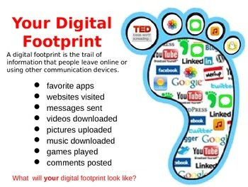


Slide 12
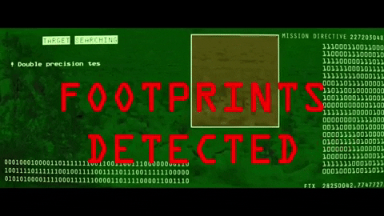
Digital Footprint
Active digital footprints
Active digital footprints consist of the data you leave when you make deliberate choices on the internet.
Few examples of active digital footprints:
Posting on Facebook, Instagram, Snapchat, Twitter, and other social media platforms
Filling out online forms, such as when signing up to receive emails or texts
Agreeing to install cookies on your devices when prompted by the browser
Notes:
For instance, posts you make to your social media channels are a form of active footprint. When you are logged into a project management or similar site, changes you make that are connected to your login name are also part of your active footprint.

Slide 13
Digital Footprint
Passive digital footprints
Passive digital footprints are those you leave behind without intending to or, in some cases, without knowing it.
Few examples of passive digital footprints:
Websites that install cookies in your device without disclosing it to you
Apps and websites that use geolocation to pinpoint your location
Social media news channels and advertisers that use your likes, shares, and comments to profile you and to serve up advertisements based on your interests
Both active and passive footprints can be tracked and observed in multiple ways and by multiple sources.

Slide 14
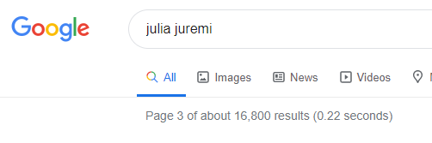
How to Minimize Your Digital Footprint?
It is wise to consider what trail of data you are leaving behind
Search Yourself
It can be eye-opening to see what personal information is publicly available

Slide 15
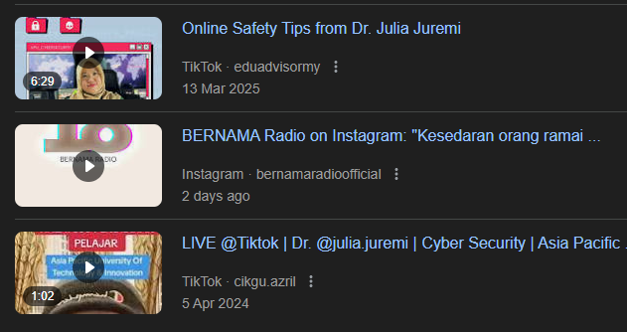
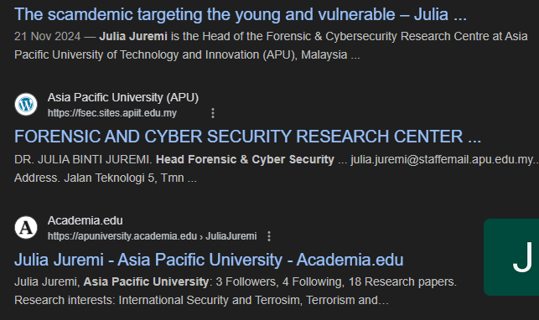
ACTIVITY:
Google Yourself
Visit https://www.google.com

Slide 16
How to Minimize Your Digital Footprint?
It is wise to consider what trail of data you are leaving behind
Search Yourself
It can be eye-opening to see what personal information is publicly available
Online Tools
Have I Been PWNED. This site will tell you if your email address has been involved in any major data breaches. If it has, be sure you’re no longer using the passwords associated with those accounts at the time of the breaches (others such as Google Alert, Mention, Talkwalker)

Slide 17
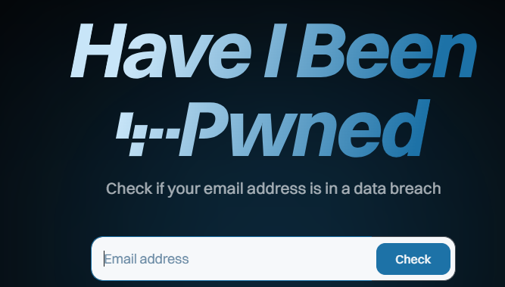
Have I been pwned?
https://haveibeenpwned.com/

Slide 18
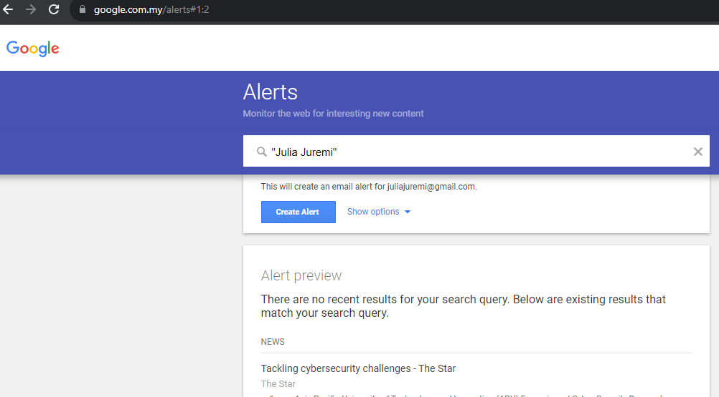
Google Alerts
Instead of you searching, Google continuously monitors the web for your chosen topic and delivers updates to you automatically.
www.google.com/alerts

Slide 19
How to Minimize Your Digital Footprint?
3. Check all your privacy settings
This is especially important for social networks. And if you have included personal information on your profiles, consider removing, reducing or hiding this. Example: Privacy setting in every social media and Google Security Check Up Tools

Slide 20
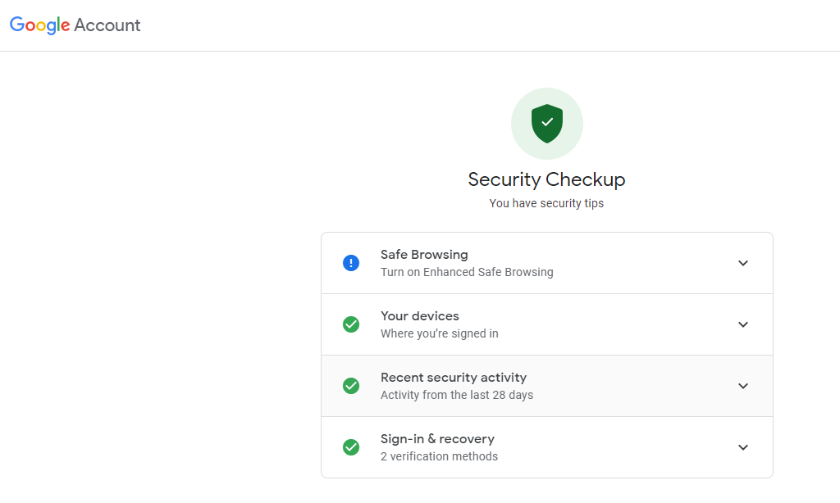
Security Check Up
https://myaccount.google.com/security-checkup

Slide 21
How to Minimize Your Digital Footprint?
3. Check all your privacy settings
This is especially important for social networks. And if you have included personal information on your profiles, consider removing, reducing or hiding this.
Use stealth mode when browsing
The Chrome browser has Incognito Mode. Microsoft Edge includes InPrivate Browsing. Firefox users have Private Window. And Safari users can also switch on private browsing from their browser's security settings.
The Tor internet browser offers high levels of anonymity, as it bounces all of your browser usage across several servers around the world making it impossible for anyone to track your internet sessions.

Slide 22

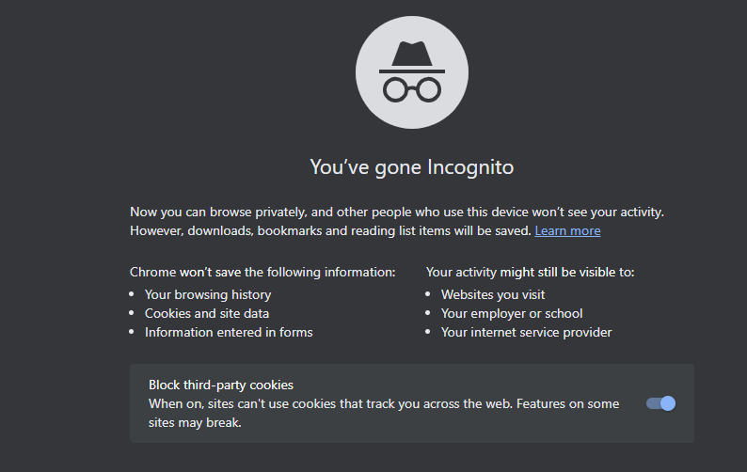

Private Browsing

Slide 23
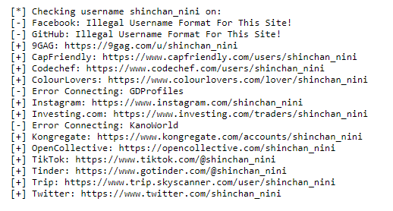
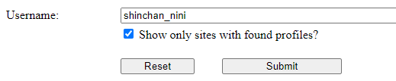
How to Minimize Your Digital Footprint?
5. Hunt Down Social Media Accounts by Usernames
Visit https://w-e-b.site/?act=sherlock

Slide 24
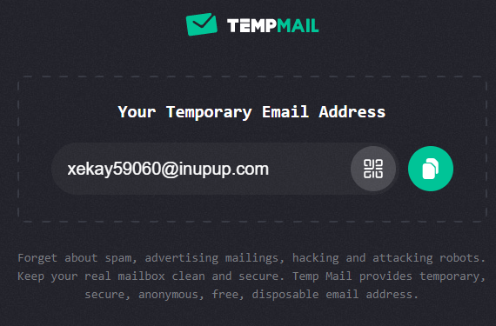
How to Minimize Your Digital Footprint?
6. Use Temporary/Disposable Email to Create Accounts
https://temp-mail.org/en/
https://tempail.com/#google_vignette
https://tempmail.net/
Notes:
https://tempmail.net/#google_vignette

Slide 25





Slide 26
INFORMATION SECURITY

Slide 27
Goals of Information Security
Information Security Goals | Description
Prevention | Various types of information need protection. Doing so can lessen losses from a security breach. Preventing unauthorized access to information is top priority.
Detection | Discovering attempts to access unauthorized data, or that information has been lost. Investigate individuals or scan data and networks for traces of the intruder.
Recovery | Disasters and intrusions can cause compromised or damaged data. You need a process to recover data from crashed systems or devices. You can also recover lost or stolen physical resources.

Slide 28




Vulnerabilities
Any condition that leaves a device open to harm (weakness).
Improperly configured or installed hardware or software.
Delays in applying and testing software and firmware patches.
Untested software or firmware patches.
Bugs in software or OSs.
Misusing software or communication protocols.
Poorly designed networks.
Poor physical security.
Insecure passwords.
Design flaws in software or OSs.
Unchecked user input.
Attacker
Unsecured Router
Information System

Slide 29








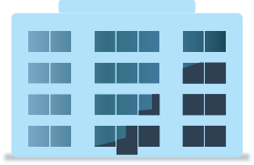

Threats
An event or action that could potentially cause damage to an asset.
Intentional or unintentional
Information Security Threats
Changes to Information
Interruption of Services
Interruption of Access
Damage to Hardware
Damage to Facilities

Slide 30

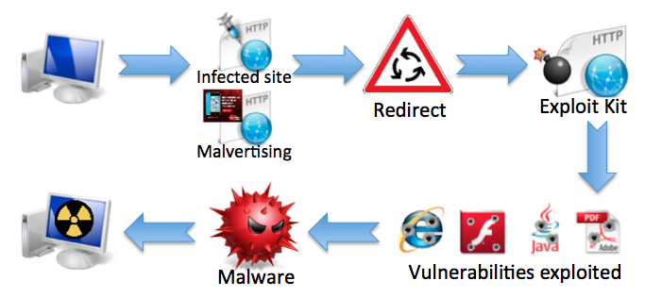



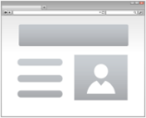
Exploit & Attack
A technique/tool/script that takes advantage of a vulnerability or weakness in a computer system or network to gain unauthorized access, perform malicious actions, or cause damage.
Physical Security Attacks
Software-Based Attacks
Social Engineering Attacks
Web Application-Based Attacks
Network-Based Attacks

Slide 31


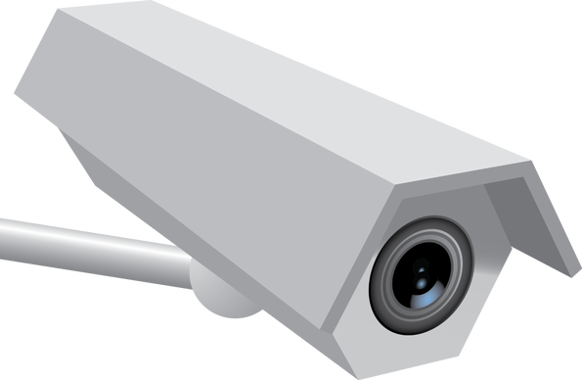


Controls
Countermeasures put in place to avoid, mitigate, or counteract security threats
Solutions and activities for meeting information security objectives.
Safeguards and countermeasures, physical or logical.
Prevention Control
Detection Control
Correction Control
Notes:
More on Layered Security

Slide 32
Types of Controls
Preventative controls: Help to prevent a threat or attack from exploiting a vulnerability. Eg: security guards.
Detective controls: Help to facilitates the detection of a security breach (real time or after an event). Eg: CCTV and alarm.
Corrective controls: Help to mitigate the consequences of a threat or attack. Eg: Backup copies.

Slide 34



CIA Triad
The three principles of security control and management: Confidentiality, Integrity, and Availability.
Integrity
Confidentiality
Availability

Slide 35
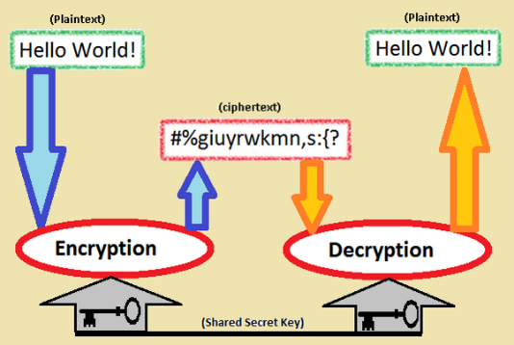
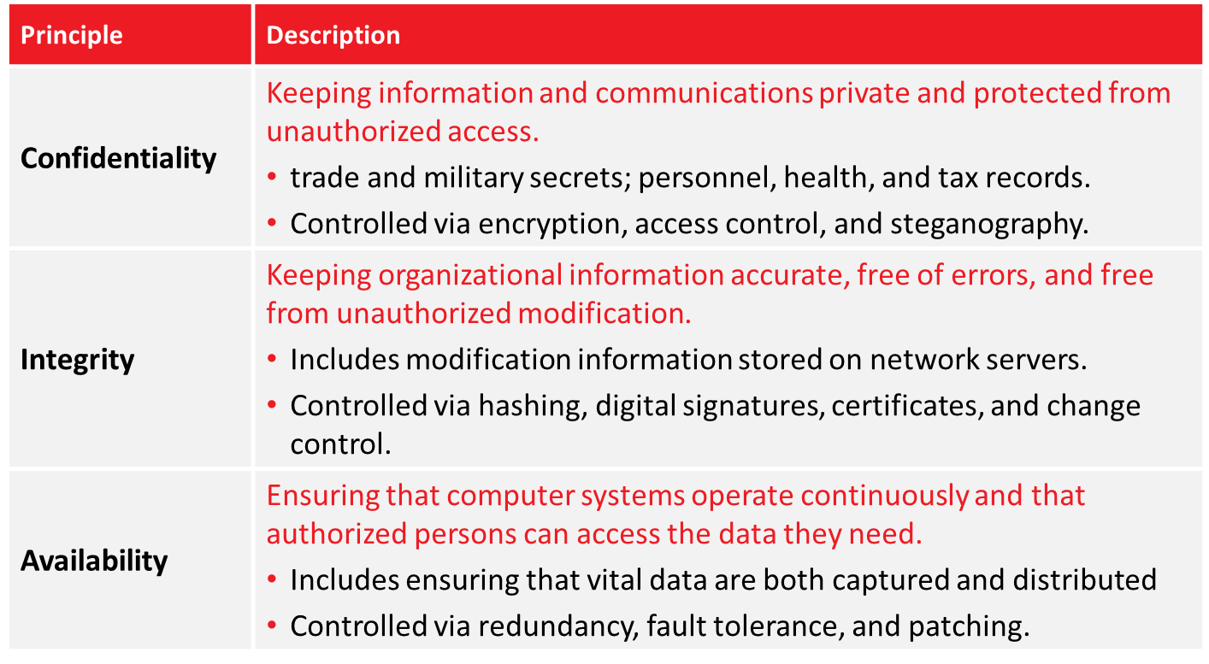
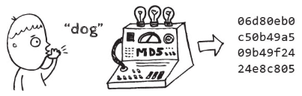
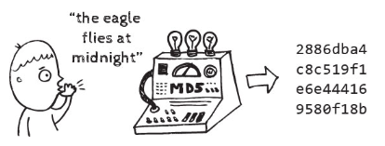
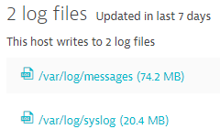
CIA Triad

Slide 36



Authentication, Authorization and Accounting (AAA)
Three separate identity-based tasks.
Verifying object identification (authentication).
Ensuring object is assigned relevant permissions (authorization).
Logging actions to create an audit trail (accounting).
AAA solutions are the gatekeepers that provide access to services.
Authentication
Authorization
Accounting

Slide 37
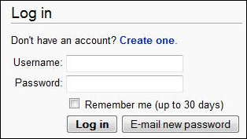

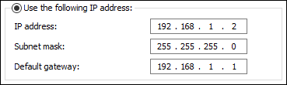
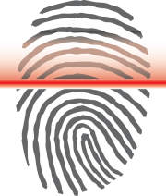
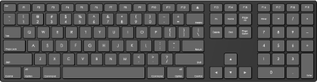
Authentication
A method of validating unique credentials of an entity / object / individual.
Something you are
Fingerprints, handprints, and retinal patterns
Something you have
Key or ID card
Something you know
Password or PIN
Somewhere you are or are not
IP address or GPS location
Something you do
Keystroke patterns or tracing picture passwords

Slide 38
Authorization
The process of determining what privileges a particular entity has.
After successful authentication, the system determines which resources the entity is authorized to access.
Privileges are assigned in advance, when the account is set up
Identification
Authentication
Authorization

Slide 39
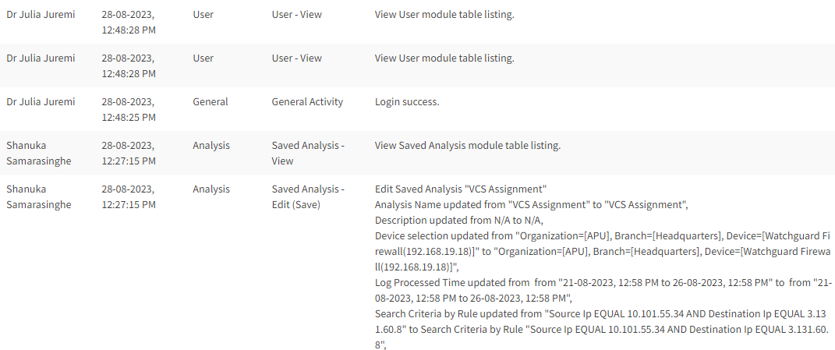
Accounting
Typical information that is gathered in accounting may be:
the identity of the user,
the nature of the service delivered,
when the service began, and when it ended.

Slide 41
Quick Review Question
JSec is an IT consultancy firm which provides services to several government sectors. There are 20 consultants and 10 part time contractors working in this firm. The office is located at 7th storey of a 10-floor building in Putrajaya. There are other companies’ offices in the building. All these offices share 6 lifts. JSec has various IT systems on multiple servers which are linked together.
From the above scenario, identify the possible vulnerabilities and potential threats.

Slide 42
DEFENSE in depth

Slide 43


Layers of Security
A successful organization should have multiple layers of security in place:
Physical security
Personnel security
Operations & Communications security
Network security
Information security

Slide 44

Example: Physical Security
To visualize: security perimeter of a building
District Perimeter
Neighbourhood Watch, Routine Police Patrols
Property Perimeter
Parking Lot Perimeter
Building Perimeter
Single-Entry Fence, Walls, Visitor Screening, Guards
Surveillance Cameras, Alarm Systems, Badge Ids
Sign-In Desk, Badge Reader Access,

Slide 45
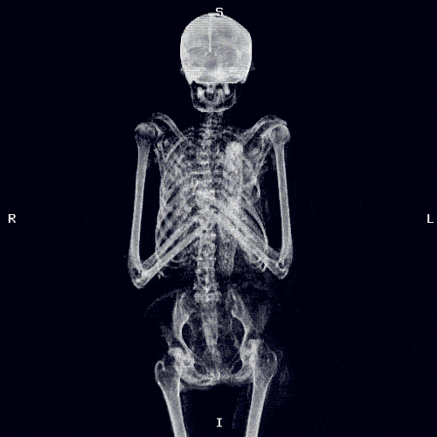
Example: Personnel Security
To visualize: personnel security
Response and Recovery Planning
Background Screening
Awareness Training
Exercises and Drills
Notes:
Personnel security is a system of policies and procedures which seek to mitigate the risk of workers (insiders) exploiting their legitimate access to an organisation's assets for unauthorised purposes.

Slide 46
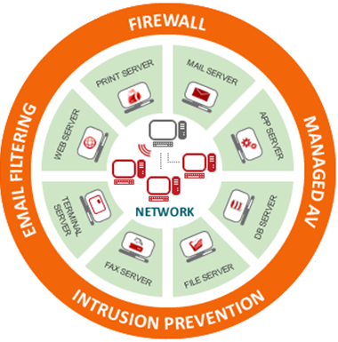
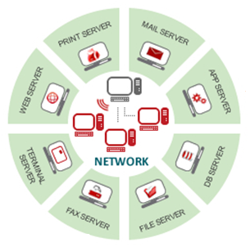
Example: Network Security
To visualize: network security of an infrastructure
Attack: Email Spam
Attack: From Internet
Attack: Virus
Attack: Spyware
Notes:
Managed AV = Managed Anti Virus enables you to centrally manage detections and events, monitor scans and protections

Slide 47
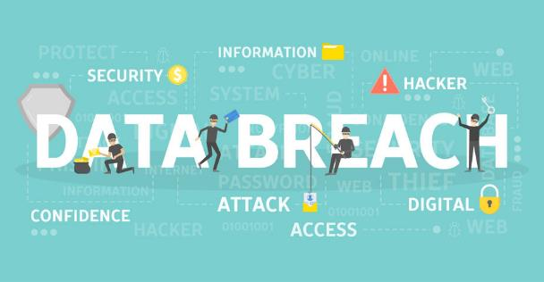
Example: Information Security
To visualize: protection of sensitive data & information
Hashing
Access Controls
Back up and Redundancy
Encryption

Slide 48
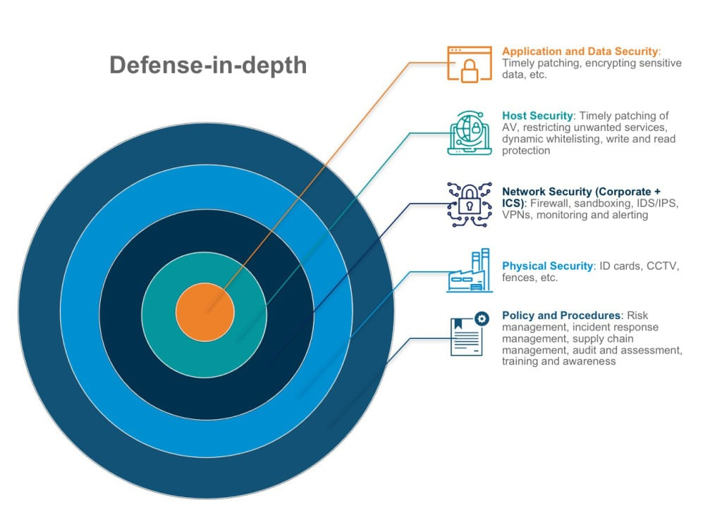
Defense-in-Depth
Using more than one of layer of protection constitutes defense-in-depth
It minimizes the probability that the efforts of malicious hackers will succeed
It forces an adversary to defeat or avoid more than one control to gain access to an asset.

Slide 49
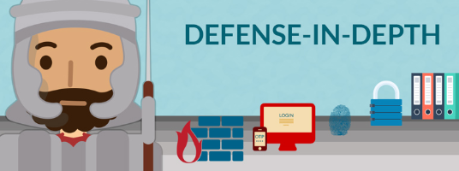
Benefits of Defense-in-Depth
• Provide multiple opportunities for monitoring to DETECT the attack
Creates a DELAY so that the attack may be interrupted and prevented

Slide 50


ACTIVITY: Windows BitLocker
1. Insert: the USB drive into your computer's USB port.
2. Open: File Explorer and find your USB drive under "This PC".
3. Right-click: on the USB drive and select Turn on BitLocker.
4. Select: the option to Use a password to unlock the drive.
5. Enter: and re-enter a strong, memorable password for the drive.
6. Choose: how you want to back up your recovery key.
- Save to a file: This option saves the key as a file to a secure location on your computer.
- Print the recovery key: This prints the key to your printer.
** Important: Store your recovery key in a secure, separate location in case you forget your password.
7. Select: an encryption option:
- Encrypt used disk space only: Faster and best for new drives.
- Encrypt entire drive: Slower but provides better protection for the entire drive.
8. Select: an encryption mode:
Compatible mode: For removable drives that can be moved to different devices.
9. Click: Start Encrypting (or Next, depending on your Windows version) to begin the process.
10. Wait: for the encryption process to complete. A notification will appear when it's done.
Now, when you insert the BitLocker-encrypted pendrive into any computer, you will be prompted for the password to access its contents.

Slide 51
Summary of Main Teaching Points
Overview of Digital World
Security Related Terms
CIA and AAA

Slide 52
What we will cover next
Cryptography, Hashing & Steganography

